Slide 1

Control Flow

Slide 2
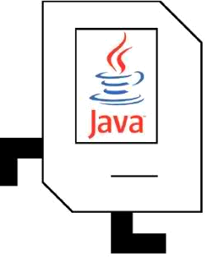
Plan For Today
Karel the Robot So Far
Control Flow
Reviewing For loops
While loops
If/else statements

Slide 3

Hi there! I’m Nick.
I’m a Computer Science Lecturer at Stanford.
Notes:
Originally from Washington, DC
I started programming with Karel, just like you!
Now I get to share how cool programming is
Wanted to get into programming to make cool things to share – hope you are excited too!

Slide 4

Plan For Today
Karel the Robot So Far
Control Flow
Reviewing For loops
While loops
If/else statements

Slide 5
Karel the Robot!
Notes:
Old Mac with leg out its back

Slide 6
Karel the Robot!
Ahoj, světe!
Notes:
Karel speaks Java! (not english)

Slide 7
Karel the Robot!
Notes:
Old Mac with leg out its back

Slide 8

Karel the Robot!
Notes:
Old Mac with leg out its back

Slide 9
Karel's World
3
.
.
.
.
.
2
.
.
.
.
.
1
.
.
.
.
.
1
2
3
4
5

Slide 10

Karel Knows 4 Main Commands
move
turnLeft
putBeeper
pickBeeper

Slide 11
Defining New Commands
We can make new commands (or methods) for Karel. This lets us decompose our program into smaller pieces that are easier to understand.
private void name() {
statement;
statement;
...
}
For example:
private void turnRight() {
turnLeft();
turnLeft();
turnLeft();
}

Slide 12
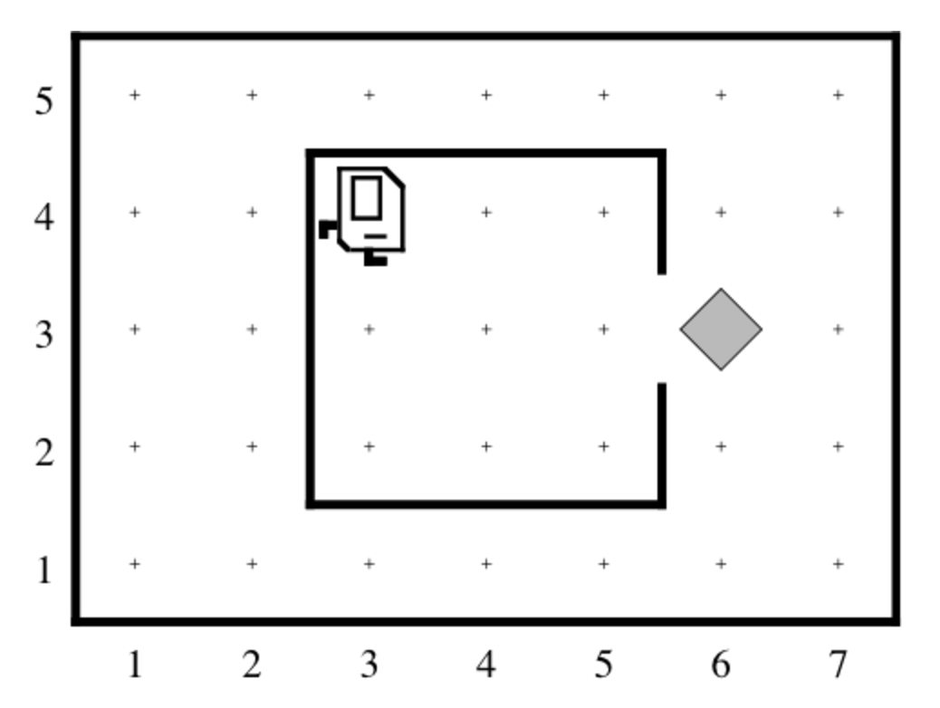
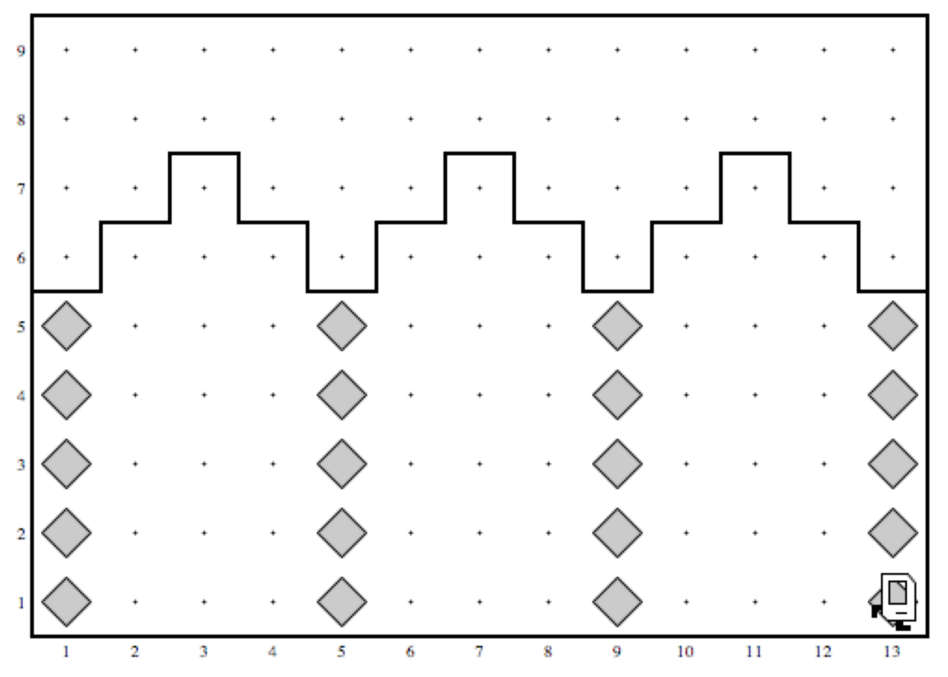
Writing Our First Karel Programs
What did you find most surprising or challenging when working on these programs?

Slide 13
Plan For Today
Karel the Robot So Far
Control Flow
Reviewing For loops
While loops
If/else statements

Slide 14
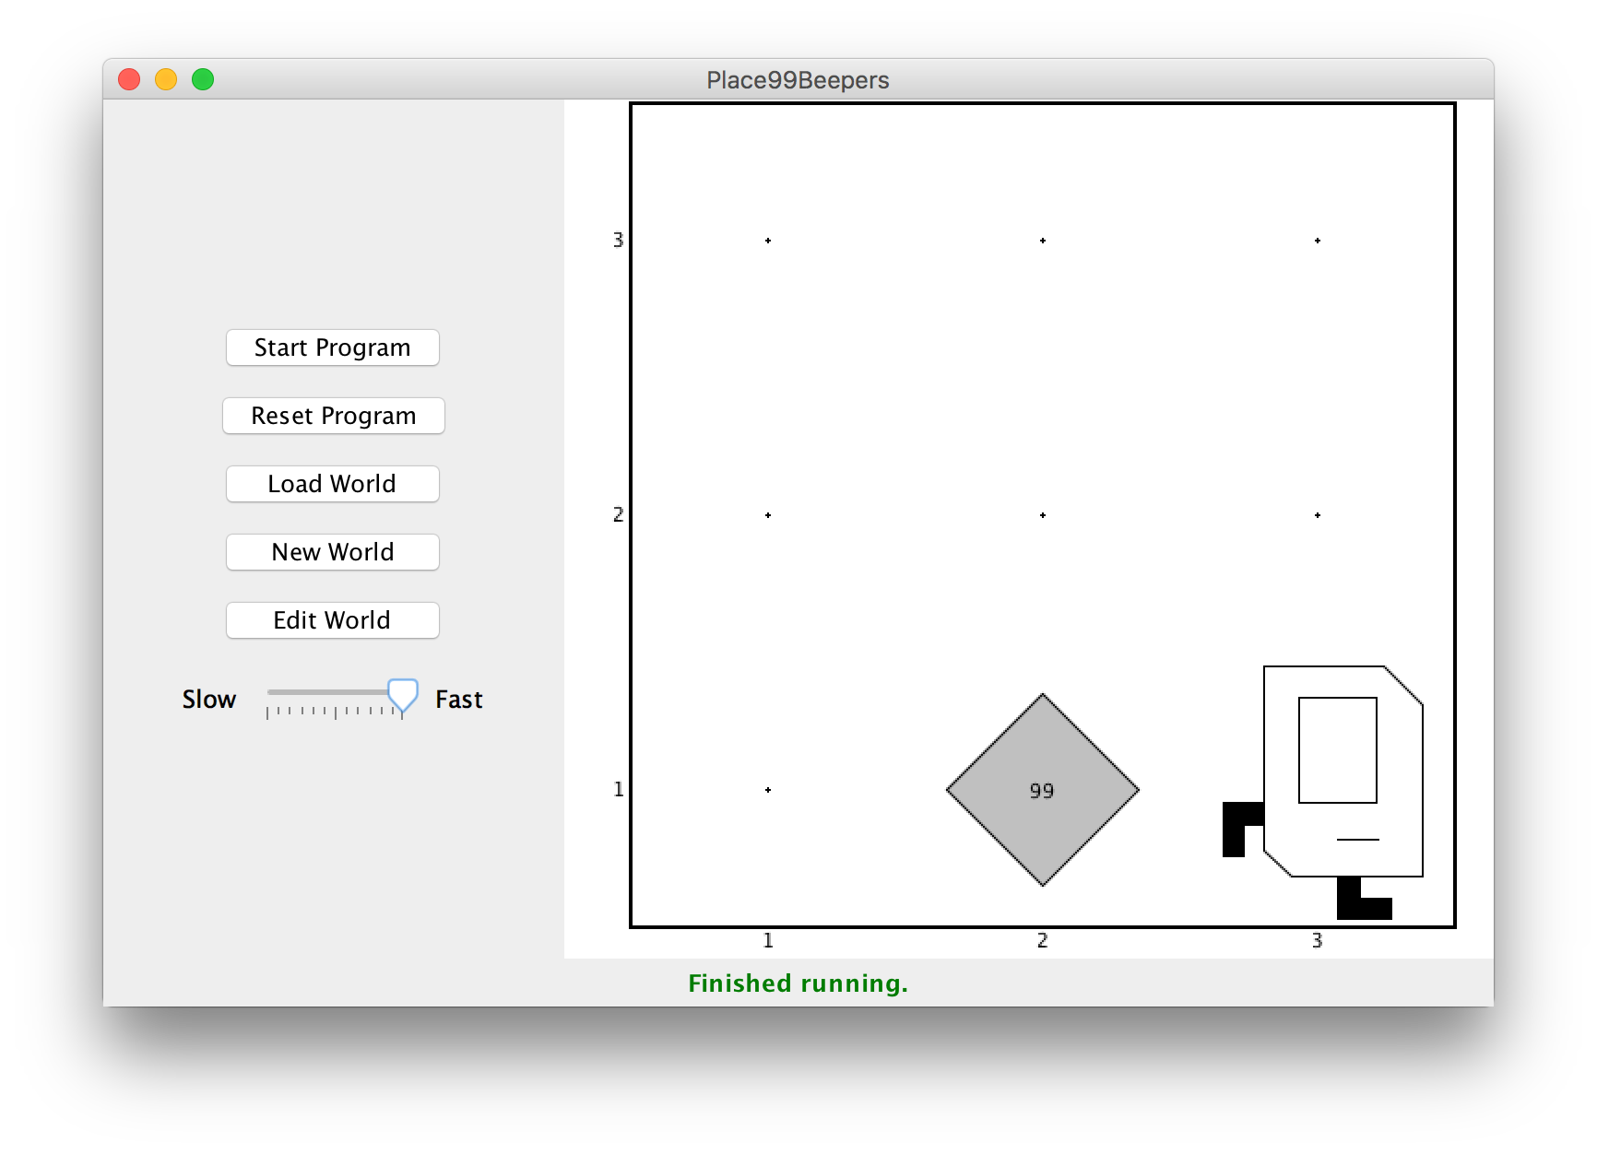
Control Flow: For Loops
I want to make Karel put 99 beepers down on a corner. How do I do this?

Slide 15
Control Flow: For Loops
move();
putBeeper();
putBeeper();
putBeeper();
...
move();
This is too repetitive! Plus, it’s difficult to change (e.g. to 25 beepers).

Slide 16
Control Flow: For Loops
Instead, use a for loop:
for (int i = 0; i < max; i++) {
statement;
statement;
...
}
Repeats the statements in the body max times.
Notes:
Executes statements in order – NOT repeating each one individually

Slide 17
Control Flow: For Loops
Now we can say:
move();
for (int i = 0; i < 99; i++) {
putBeeper();
}
move();
This is less repetitive, and is easier to change (e.g. to 25 beepers).

Slide 18
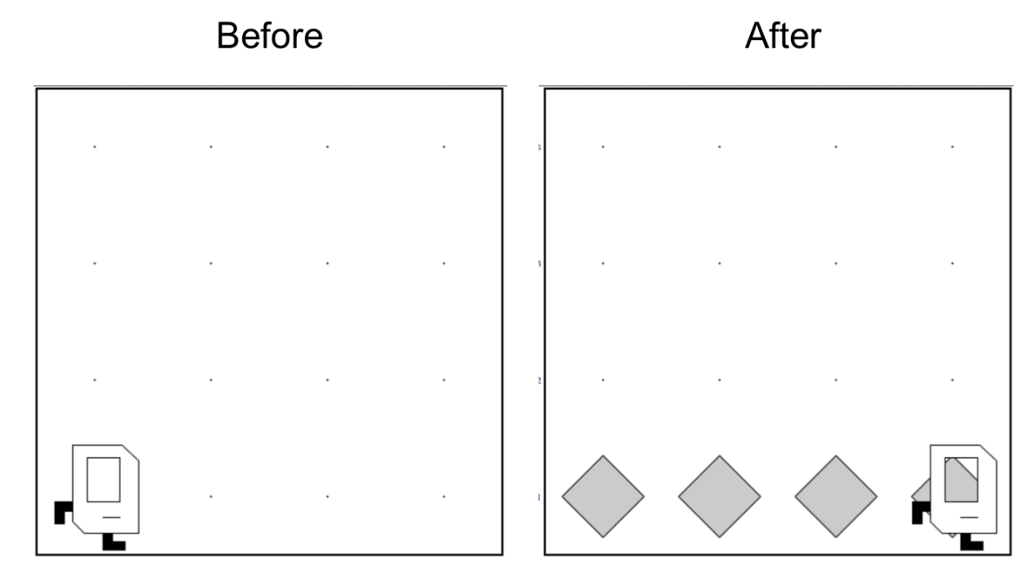
Next: Place Beeper Line

Slide 19

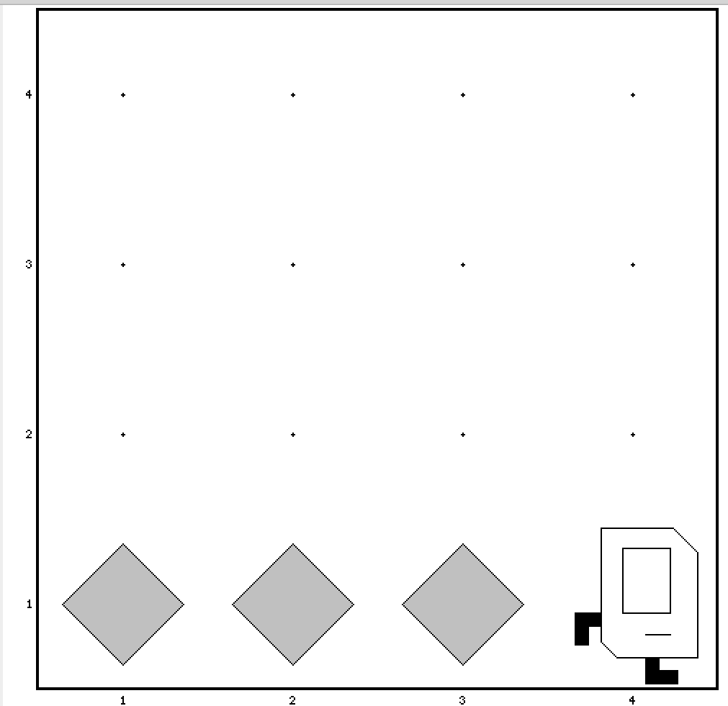
Place Beeper Line
import stanford.karel.*;
public class BeeperLine extends SuperKarel {
public void run() {
for (int i = 0; i < 4; i++) {
putBeeper();
move();
}
}
}

Slide 20
We Have A Bug!
A bug is an issue where our program does not work the way we want it to.

Slide 21
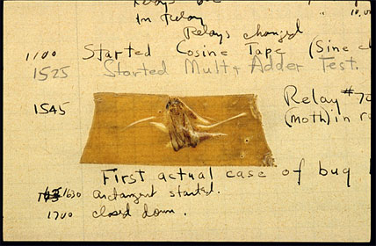
Actual Bug From Mark II

Slide 22
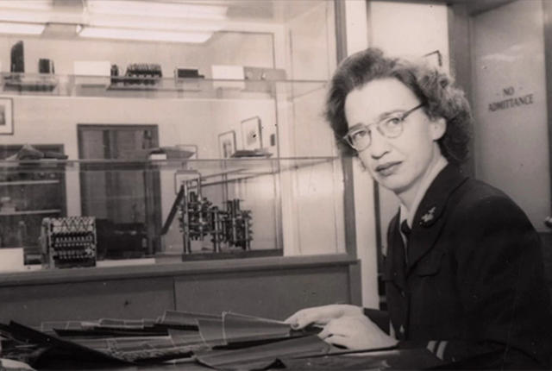
Grace Hopper

Slide 23
Rest Of Today
Implement your own Build Charles Bridge program that you talked about in section
Write a program “Mountain Karel” where Karel climbs a mountain of any size and places a beeper on top
If you have time, write a program “Random Painter” where Karel paints any world randomly with green and blue squares.

Slide 24
Plan For Today
Karel the Robot So Far
Control Flow
Reviewing For Loops
While loops
If/else statements

Slide 25
Control Flow
So far, we have written programs that behave the same every time.
More complex programs behave differently in different worlds or cases.
We are going to learn how to write Karel programs that can do things based on what the world is like!

Slide 26
Generalized Programs
?

Slide 27
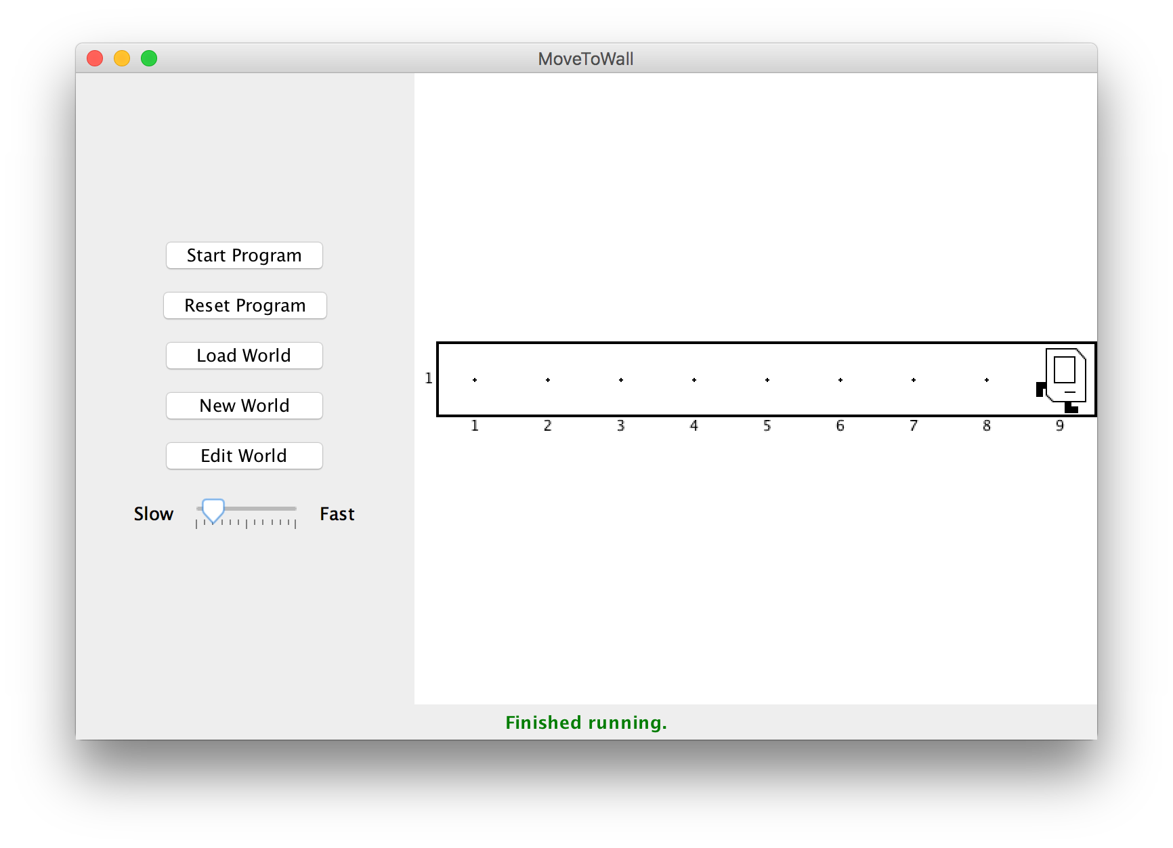
Control Flow: While Loops
I want Karel to move until reaching a wall. How do I do this?

Slide 28
Control Flow: While Loops
Can’t just say:
move();
move();
move();
move();
...
This is too repetitive! Also, we might not know how far away a wall is. Plus, we want our program to be as generalized as possible and work in many different worlds.

Slide 29
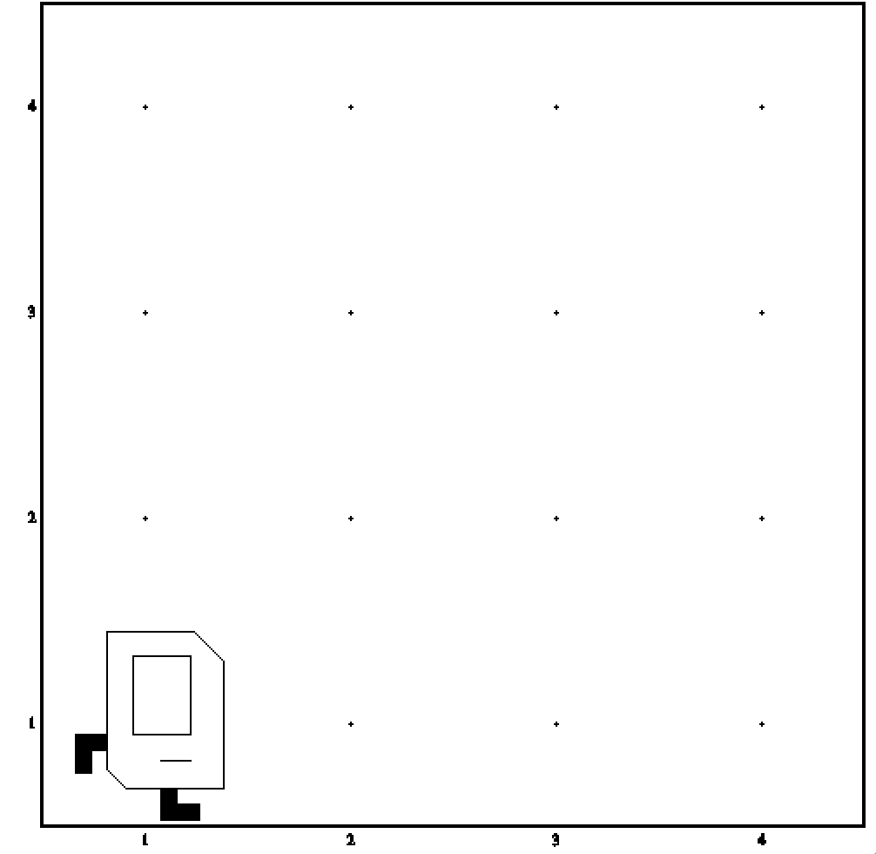
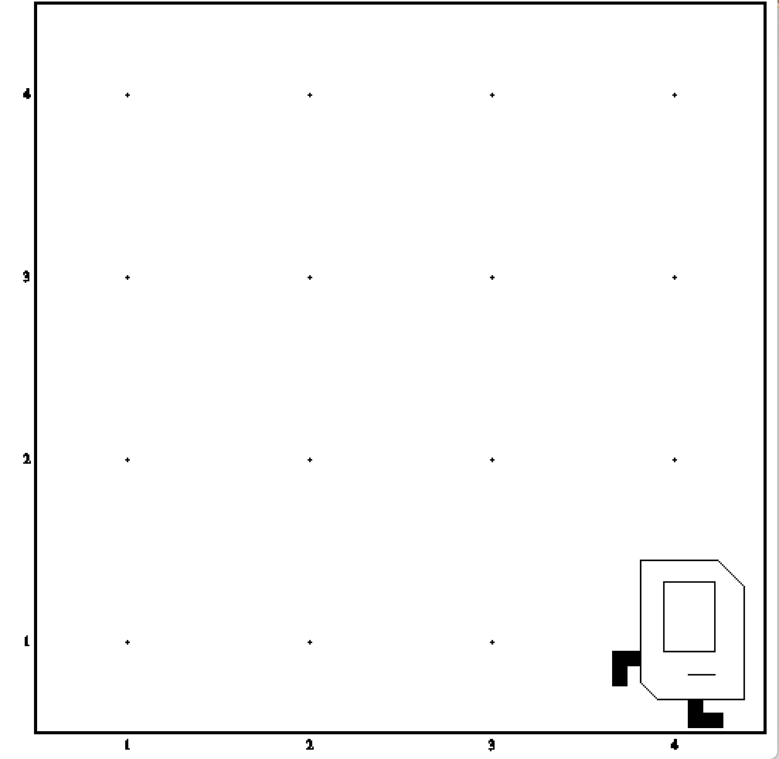
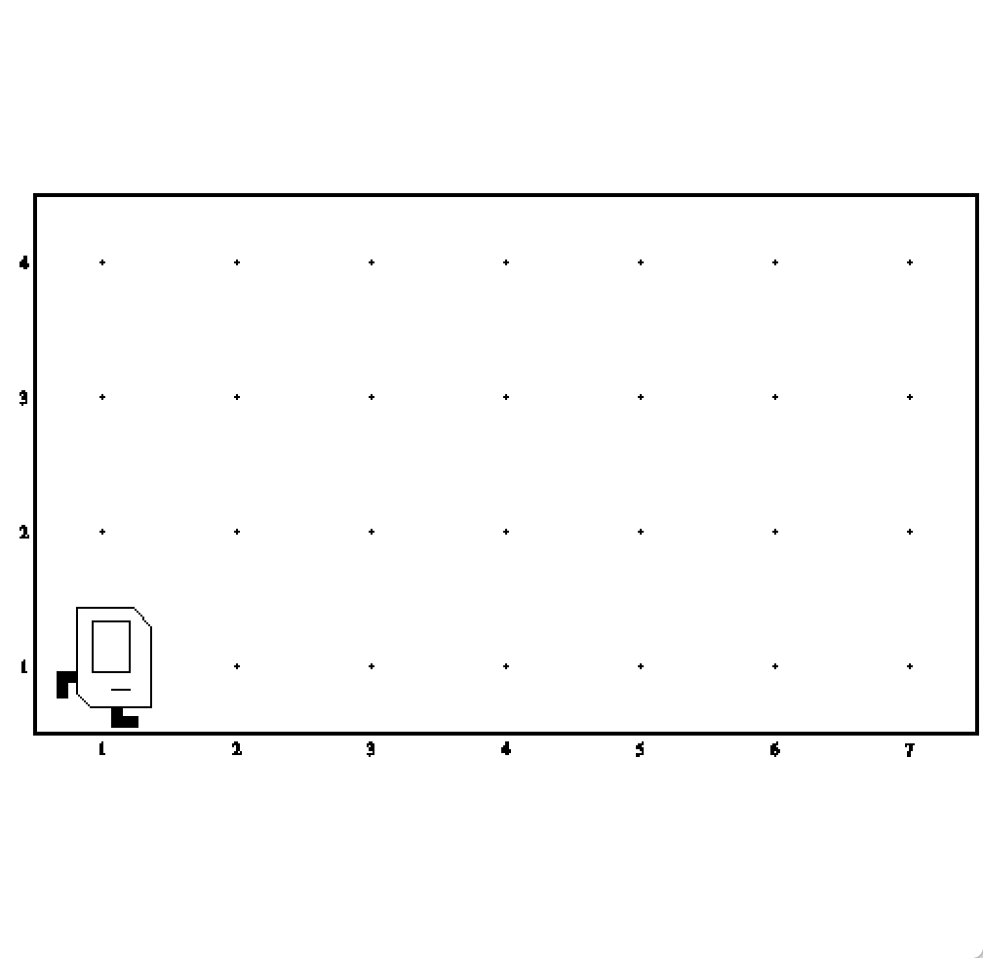
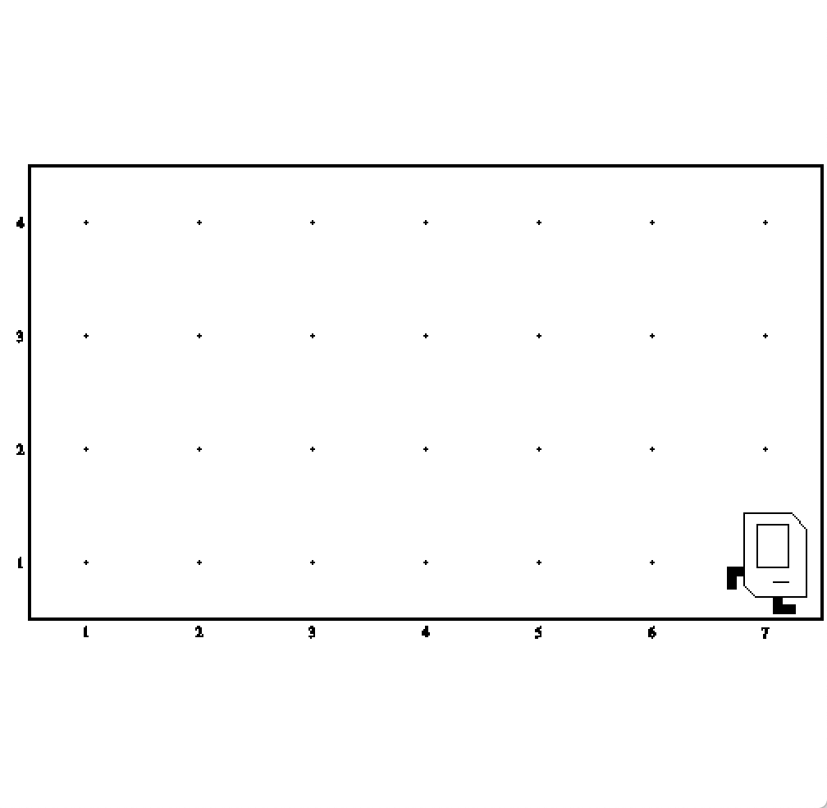
Working In Any World

Slide 30
Control Flow: While Loops
Instead, use a while loop:
while (condition) {
statement;
statement;
...
}
Repeats the statements in the body until condition is no longer true.
Each time, Karel checks the condition, and then executes all statements before checking the condition again.
Notes:
Karel can ask some questions about its world / surroundings

Slide 31
Possible Conditions
Test | Opposite | What it checks
frontIsClear() | frontIsBlocked() | Is there a wall in front of Karel?
leftIsClear() | leftIsBlocked() | Is there a wall to Karel’s left?
rightIsClear() | rightIsBlocked() | Is there a wall to Karel’s right?
beepersPresent() | noBeepersPresent() | Are there beepers on this corner?
beepersInBag() | noBeepersInBag() | Any there beepers in Karel’s bag?
facingNorth() | notFacingNorth() | Is Karel facing north?
facingEast() | notFacingEast() | Is Karel facing east?
facingSouth() | notFacingSouth() | Is Karel facing south?
facingWest() | notFacingWest() | Is Karel facing west?
This is on the course website, under the “Handouts” tab.

Slide 32
Control Flow: While Loops
Now we can say:
while (frontIsClear()) {
move();
}
This is less repetitive, and it works in any size world!

Slide 33
Loops Overview
I want Karel to repeat some commands!
Know how many times
Don’t know how many times
for loop
while loop
Notes:
E.g. “pick up all the beepers on this square”
E.g. “turn until you’re facing west”
E.g. “put down 5 beepers”

Slide 34
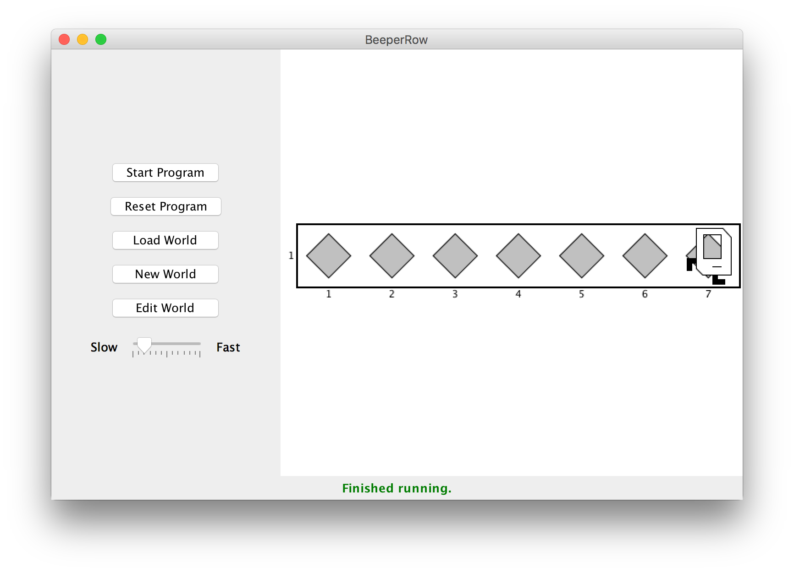
Loops Overview
I want Karel to put down a row of beepers until it reaches a wall. How do I do this?

Slide 35
Demo: BeeperLine
Notes:
What kind of loop do we want?
What task are we repeating?
Loop condition checked only at top
When do we want to stop?
Off by one
Works in a variety of worlds

Slide 36
BeeperLine Solution
public void run() {
while (frontIsClear()) {
putBeeper();
move();
}
// put one last beeper once we reach a wall
putBeeper();
}

Slide 37
Plan For Today
Karel the Robot So Far
Control Flow
Reviewing For Loops
While loops
If/else statements

Slide 38
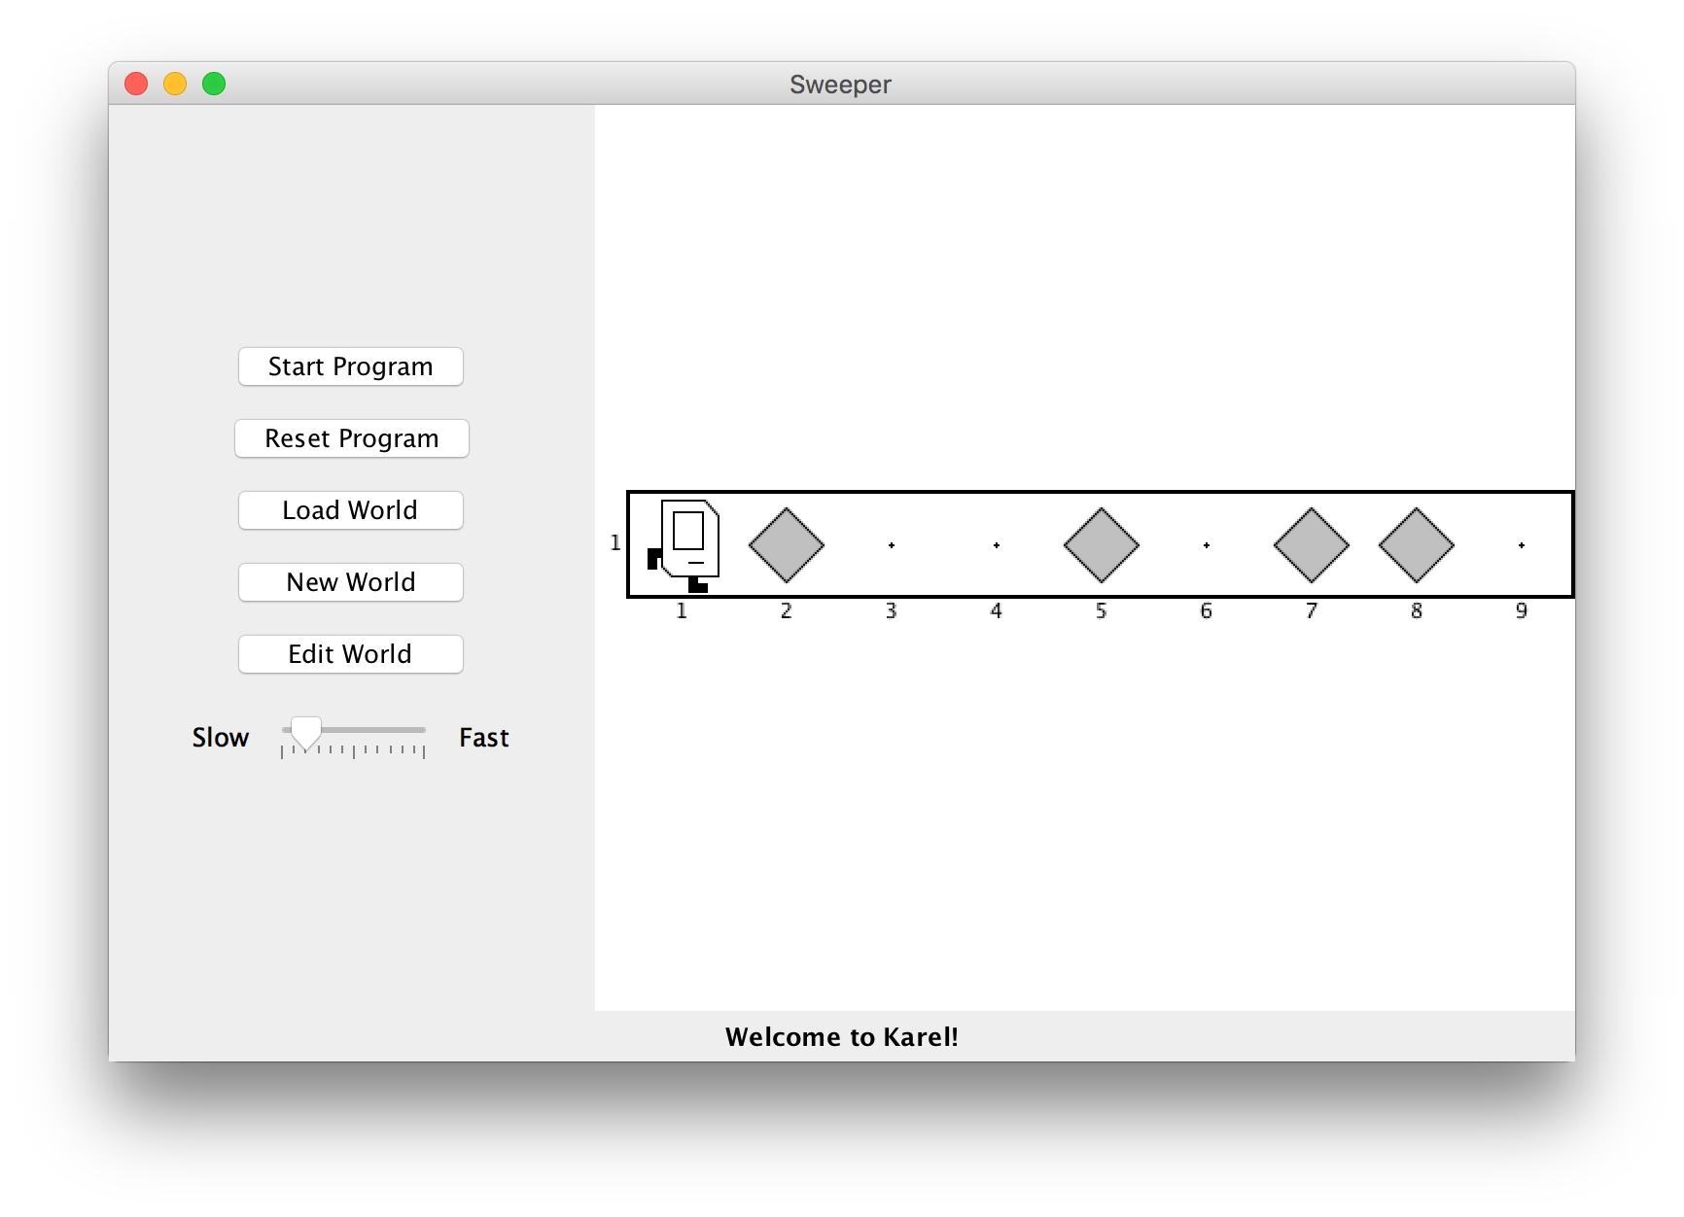
If/Else Statements
I want to make Karel clean up all beepers in front of it until it reaches a wall. How do I do this?

Slide 39
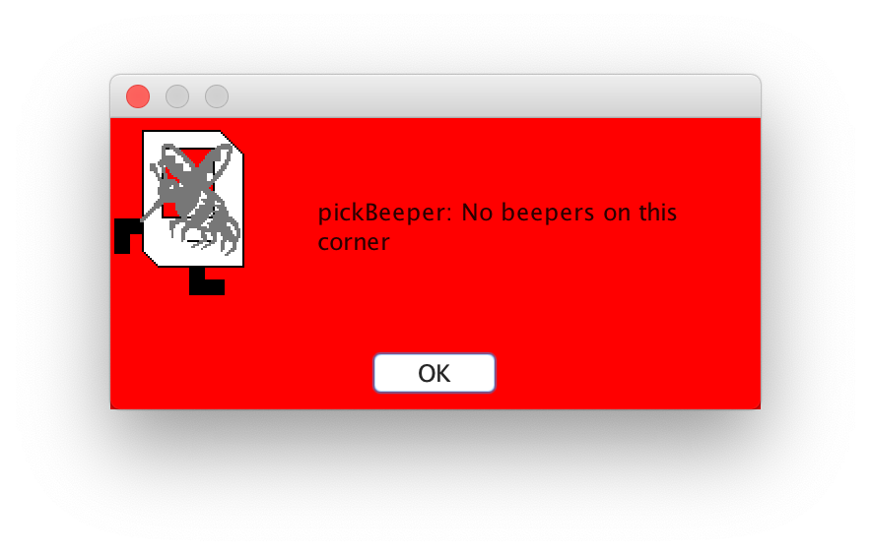
If/Else Statements
Can’t just say:
while (frontIsClear()) {
move();
pickBeeper();
}
This may crash, because Karel cannot pick up beepers if there aren’t any. We don’t always want Karel to pick up beepers; just when there is a beeper to pick up.

Slide 40
If/Else Statements
Instead, use an if statement:
if (condition) {
statement;
statement;
...
}
Runs the statements in the body once if condition is true.
Notes:
Karel can ask some questions about its world / surroundings

Slide 41
If/Else Statements
You can also add an else statement:
if (condition) {
statement;
statement;
...
} else {
statement;
statement;
...
}
Runs the first group of statements if condition is true; otherwise, runs the second group of statements.
Notes:
Karel can ask some questions about its world / surroundings

Slide 42
If/Else Statements
Now we can say:
while (frontIsClear()) {
move();
if (beepersPresent()) {
pickBeeper();
}
}
Now, Karel won’t crash because it will only pickBeeper if there is one.

Slide 43
What Does This Do?
import stanford.karel.*;
public class IfExample extends SuperKarel {
public void run() {
if (beeperPresent()) {
pickBeeper();
} else {
putBeeper();
}
}
}

Slide 44
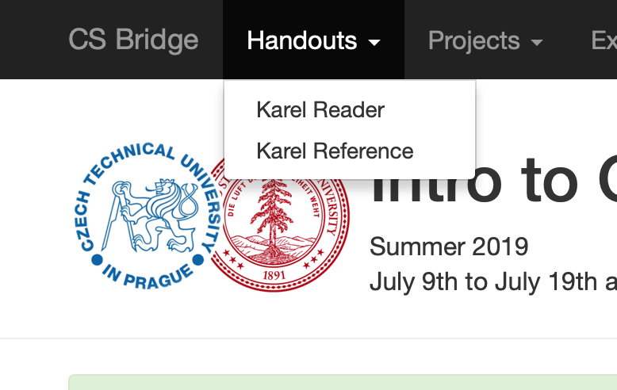
Karel Resources

Slide 45
Rest Of Today
Implement your own Build Charles Bridge program that you talked about in section
Write a program “Mountain Karel” where Karel climbs a mountain of any size and places a beeper on top
If you have time, write a program “Random Painter” where Karel paints any world randomly with green and blue squares.

Slide 46
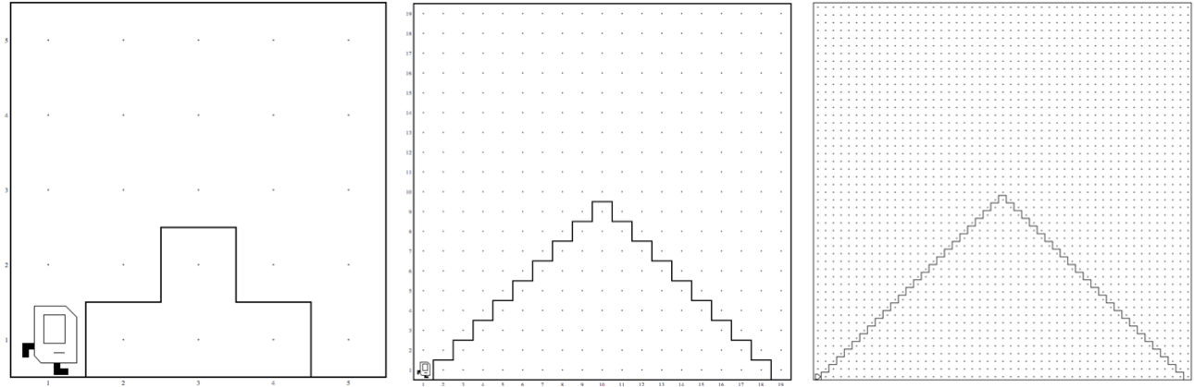
Mountain Karel
These programs should work on worlds of any size, as long as they obey the requirements given in the problem.

Slide 47

What If I Finish Early?

Slide 48
Recap
Karel the Robot So Far
Control Flow
Reviewing For Loops
While loops
If/else statements
Tomorrow: transitioning from Karel to Java

